Slide 1
Emporio sirenuse
By Kimia Mavon, Karan R Motwani, Moreno Vendra and Francesca Morini

Slide 2
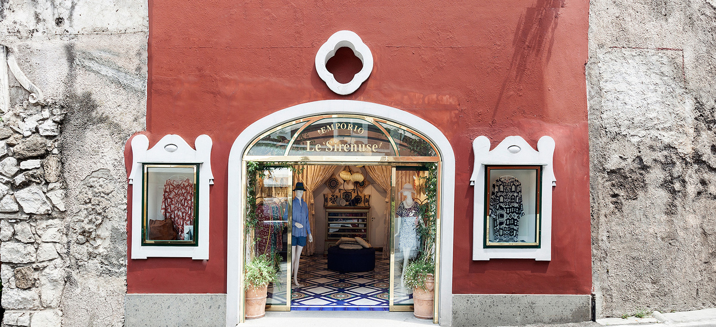
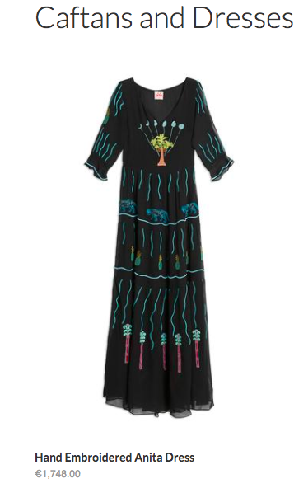

Who are they?
Our client is the Italian fashion and hotel brand ‘Le Sirenuse’.
They sell high range designer resort wear from their marquee store in Positano, Italy named ‘Emporio Sirenuse’.
Products include Caftans, Dresses, Swimsuits etc.

Slide 3
Current Situation :
The brand has low social media activity with just :
3K Instagram followers, 400 posts
441 Twitter followers
2.7K Facebook page likes
and exactly 1 Google review.
Sales have saturated around 100K Euros.
They share their heritage with the hotel but want to establish themselves as an independent entity.

Slide 4
Goal
To increase the outreach and boost the revenue of the fashion brand by understanding the current customer and social media profile.

Slide 5
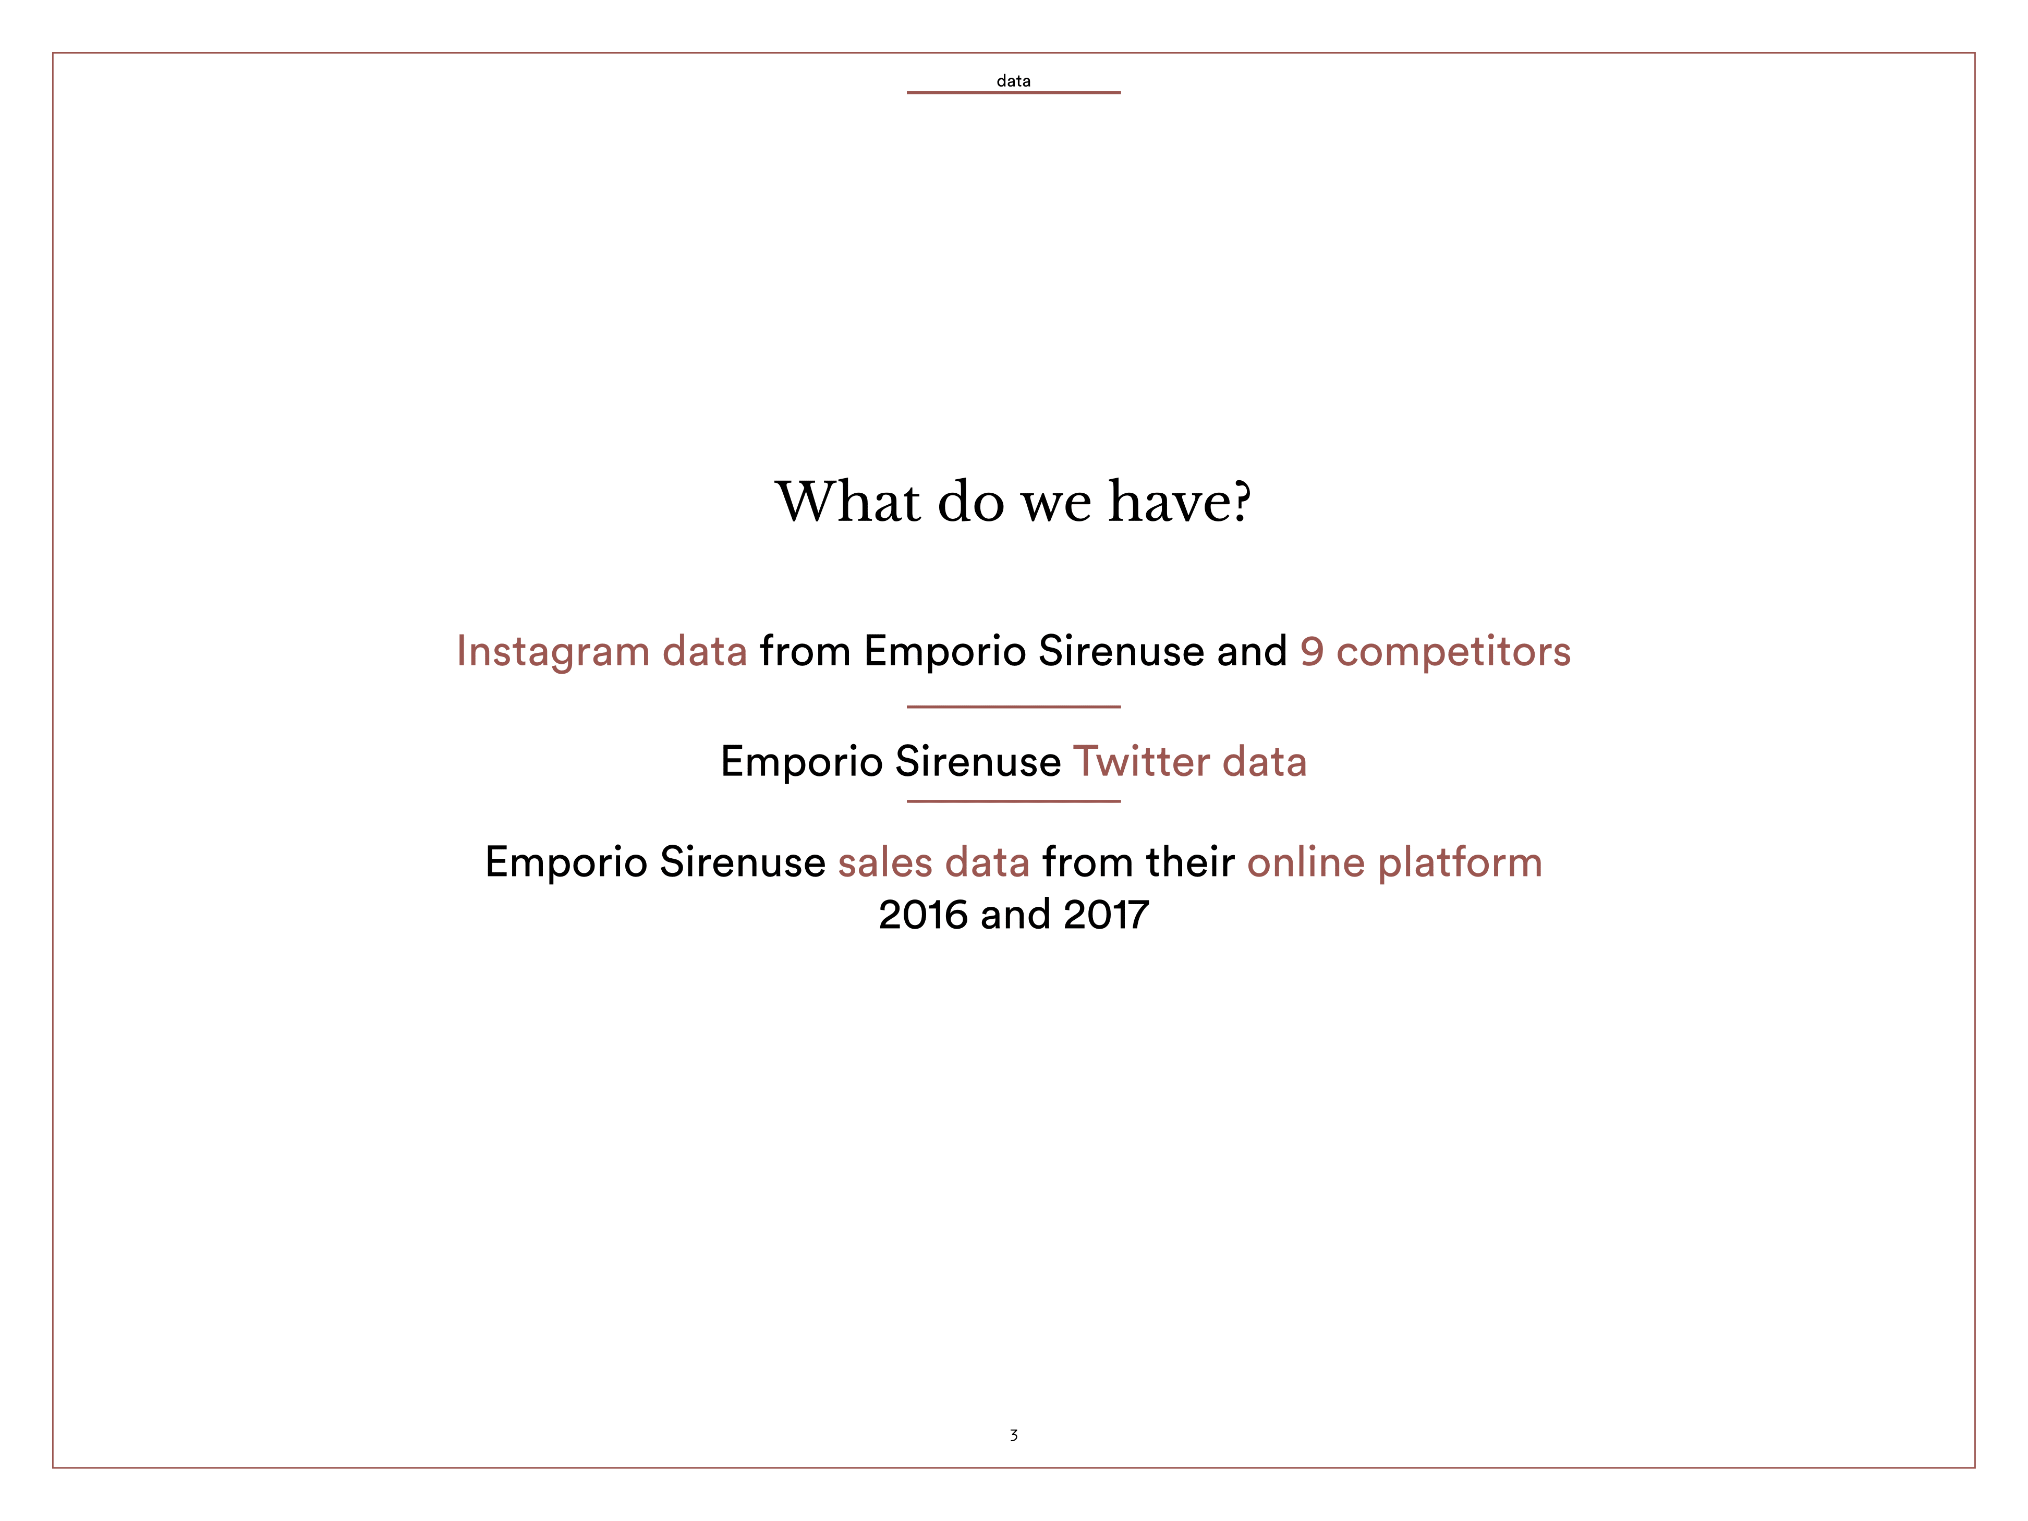

Slide 6
Why is this problem hard?
User profiling and customer segmentation is difficult with roughly 3K users.
Could scrape more.
There is no information linking social media followers and online customers.
Technically Hard:
Natural Language Processing
Computer Vision
Neural Net

Slide 7
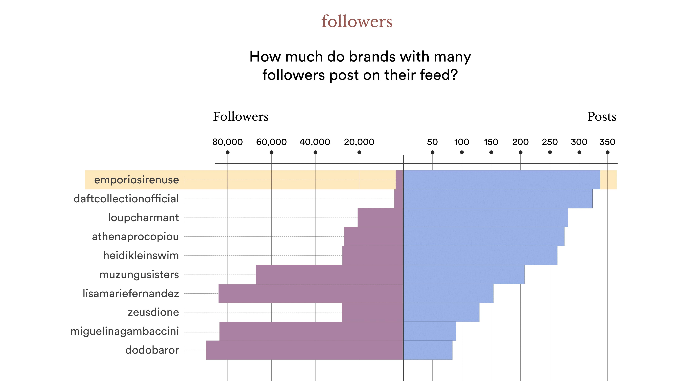

Slide 8
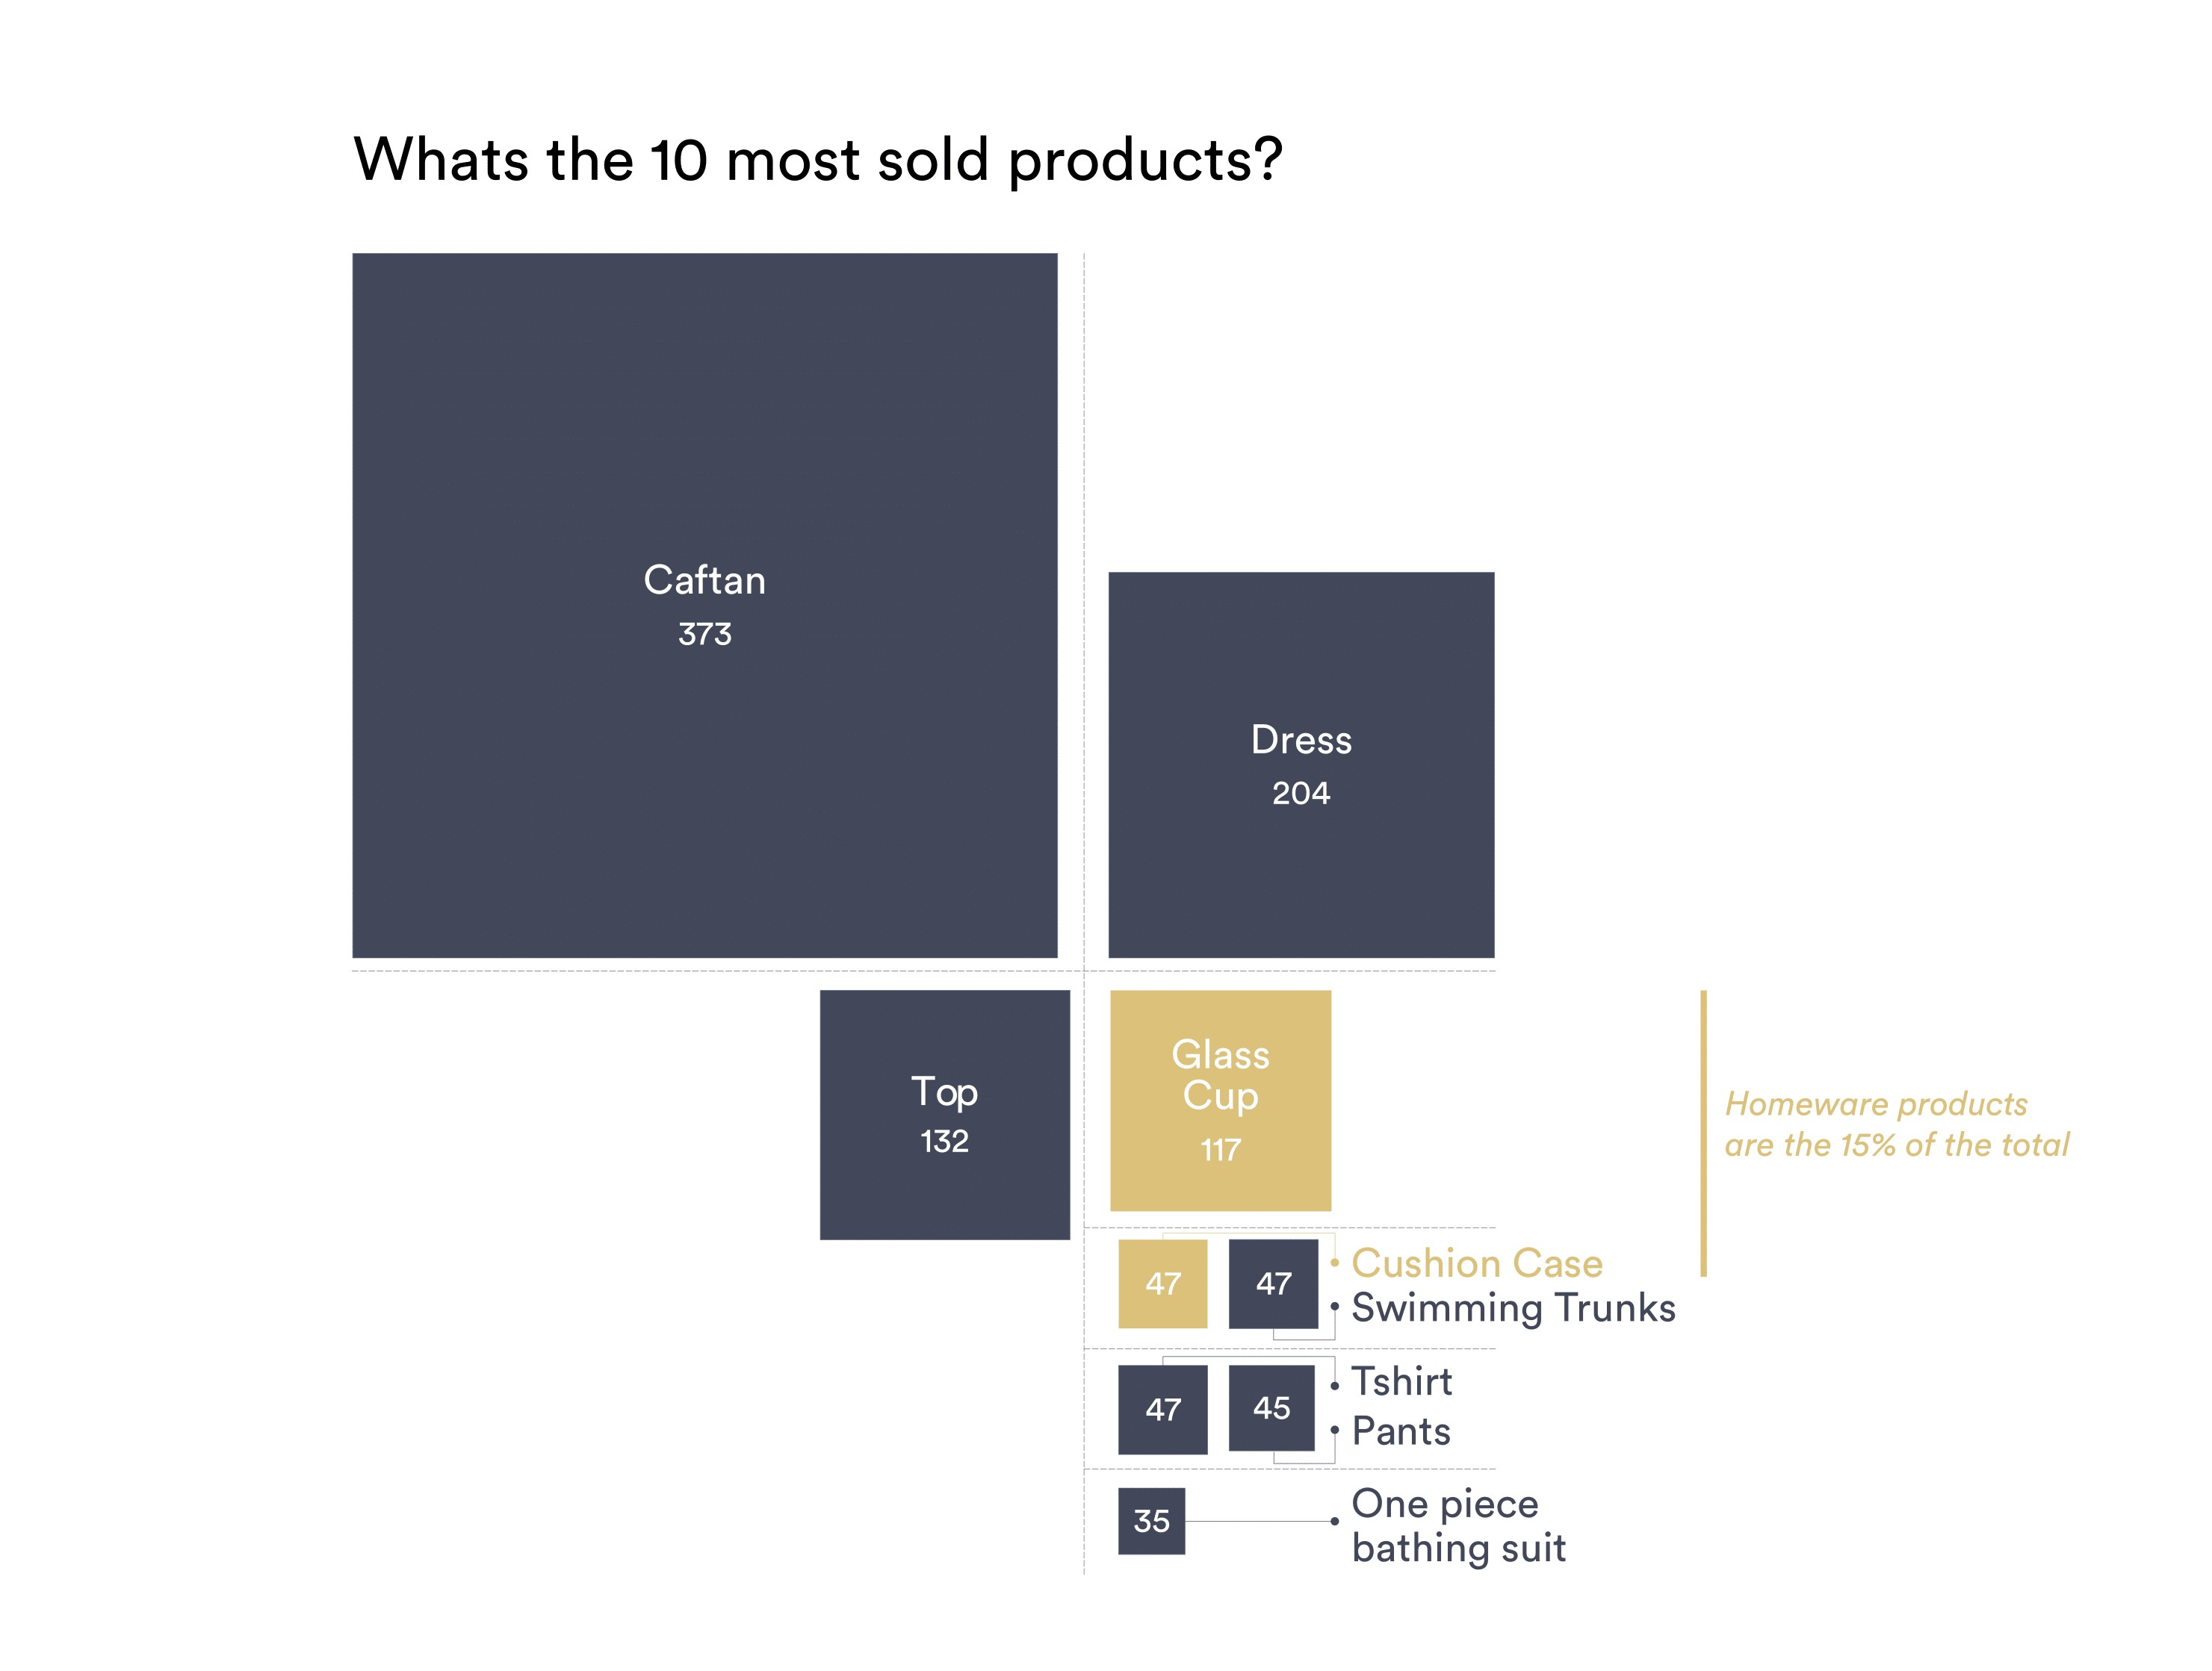

Slide 9
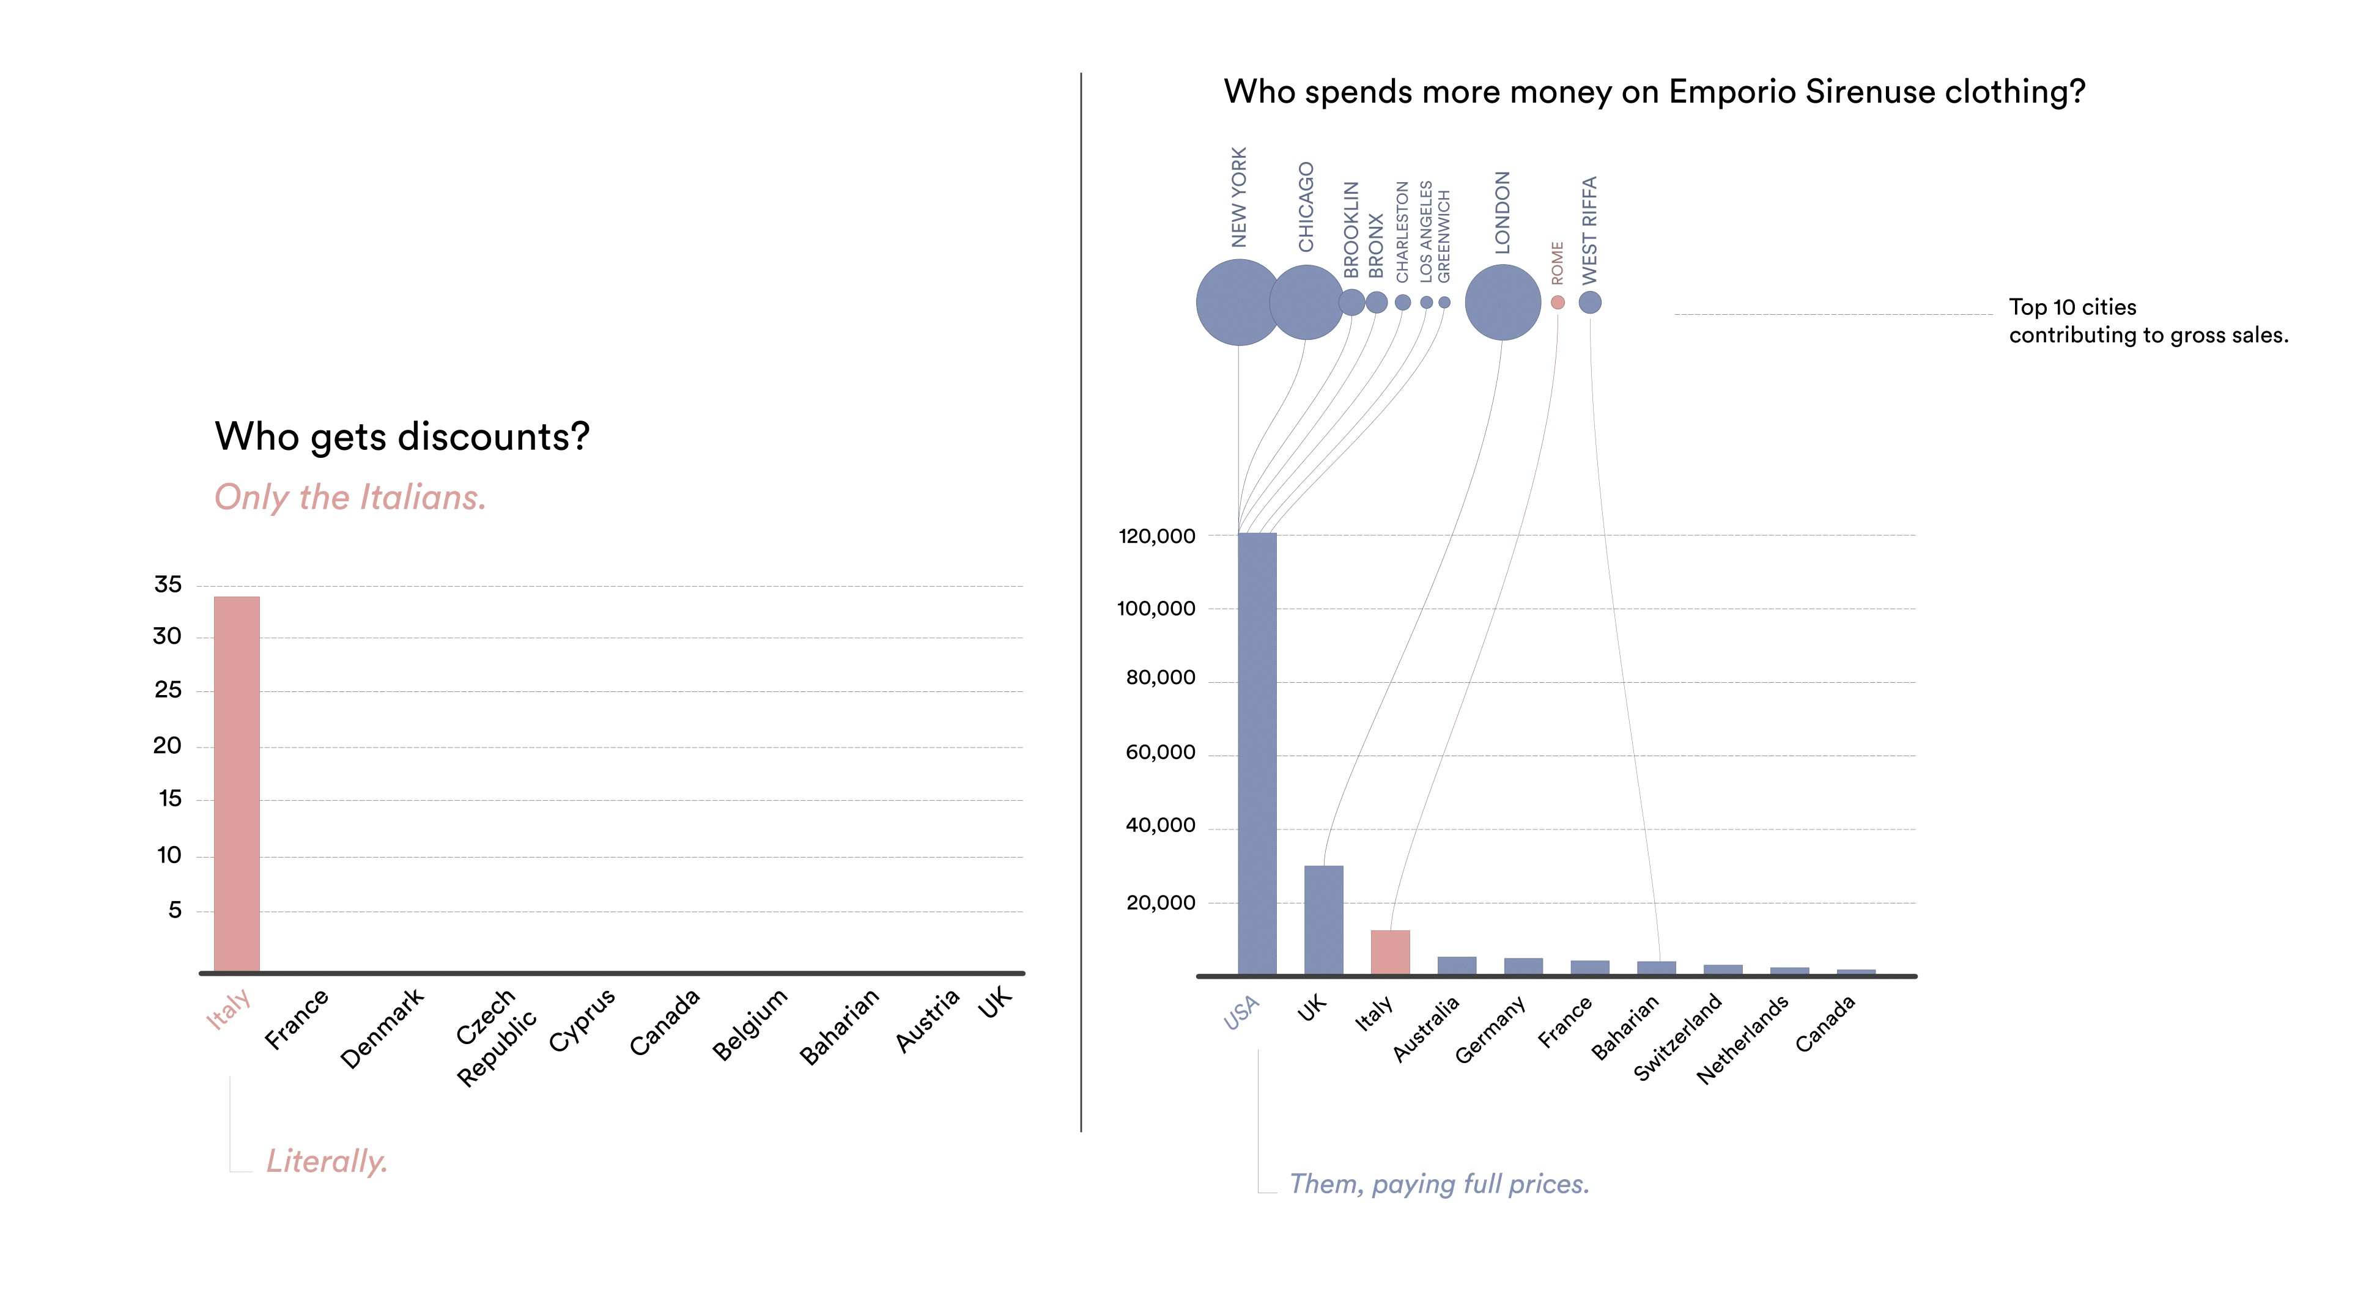
Exploratory Data Analysis

Slide 10
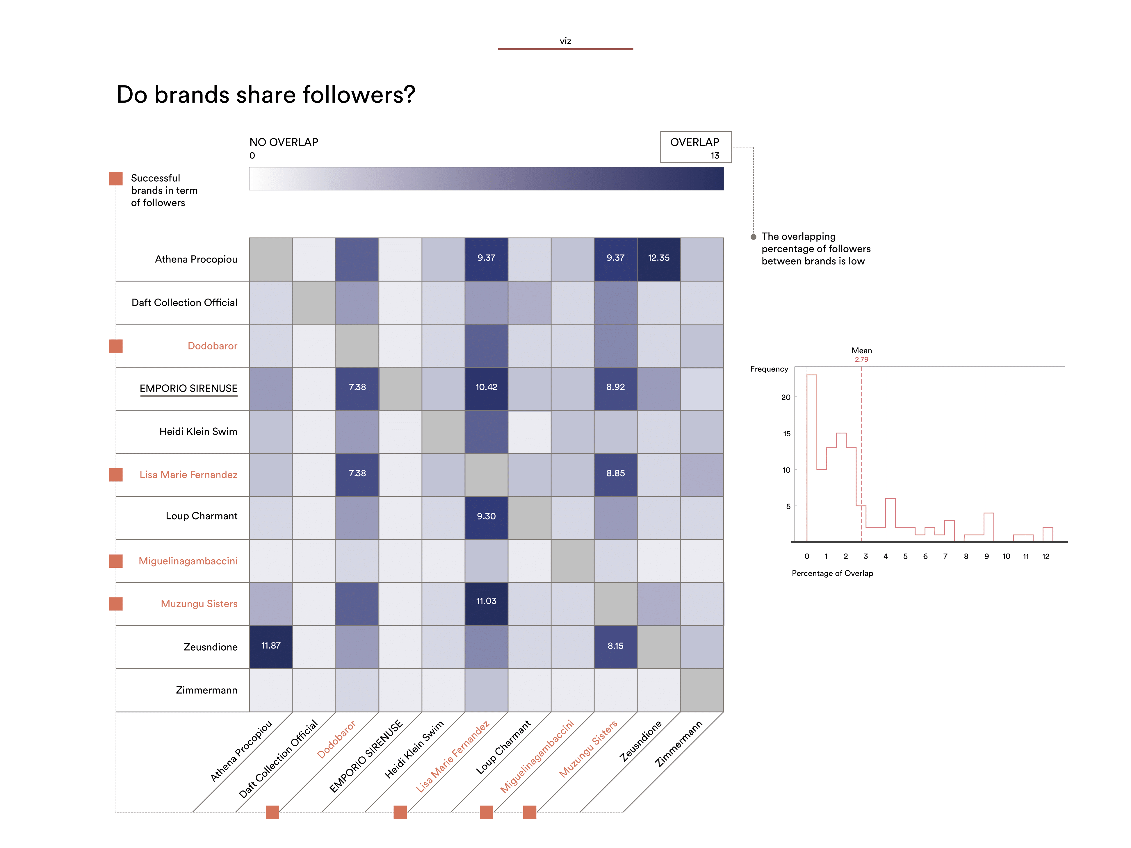

Slide 11
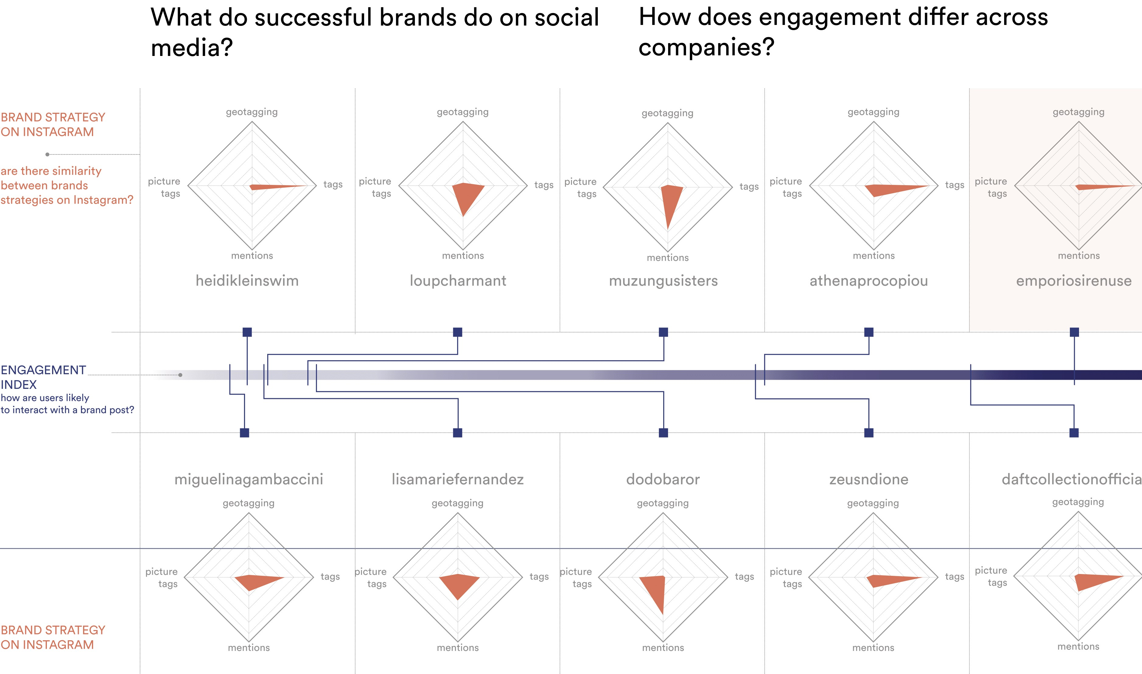

Slide 12
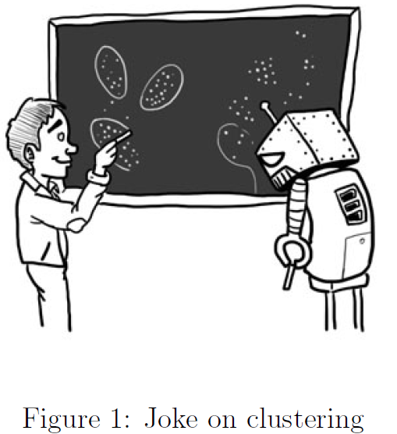
Identifying Trends (in the works)
What groups of people are on this platform?
Fashionista! → potential buyer!
“Influencer” → ex-bachelor contestant
Media → not helpful
Retailer/Brand → not helpful
Do potential buyers converge on a shared language/#hashtags?
Do potential buyers have a theme in their posts
Pictures (is this legal? If you don’t ask Pavlos, yes.)
Filters
K-Means Clustering

Slide 13
Research Questions moving forward :
What is the profile of the users the brand is currently marketing to on social media?
What is the lifestyle of these users?
Filter type, #hashtag, captions, etc
Are they customers or fashion enthusiasts?
What is relevant content to these users?

Slide 14
Potential Scope of the Project
Option 1 : Analyze the profile and demographic of the followers on social media and cluster/segment them into spheres for more targeted marketing.
Option 2 : Create a model that can suggest relevant content to the marketing department based on a black box metric of follower/customer preference.

Slide 15
Conclusion
Social Media Profiling and Targeted Marketing are contemporary concepts which makes the project very exciting.
There are potential avenues for Emporio Sirenuse to improve their Marketing strategy and contemporary Machine Learning techniques would go a long way in helping them.
We will be narrowing down the scope of the project in the coming days and look forward to begin soon!

Slide 16
Thank you ☺

